Slide 1
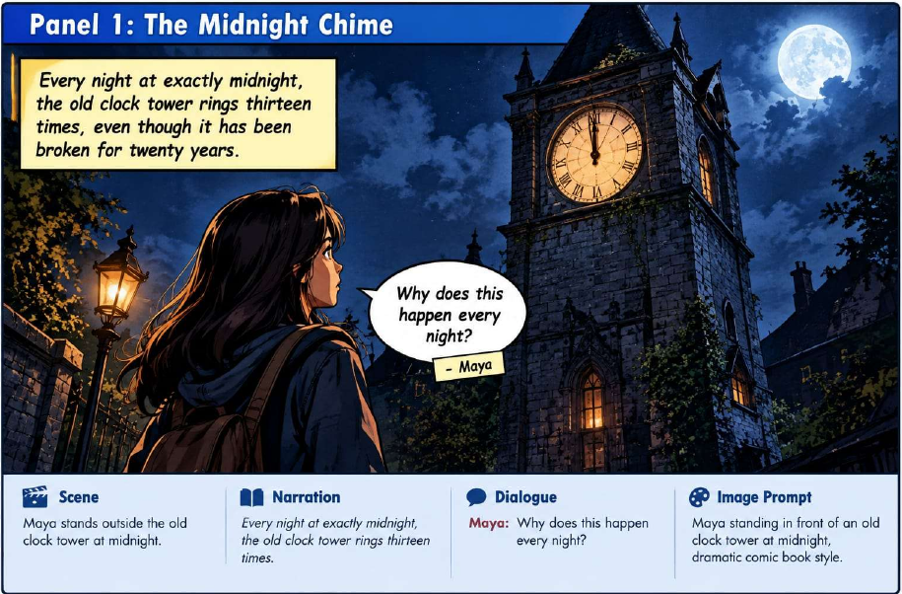
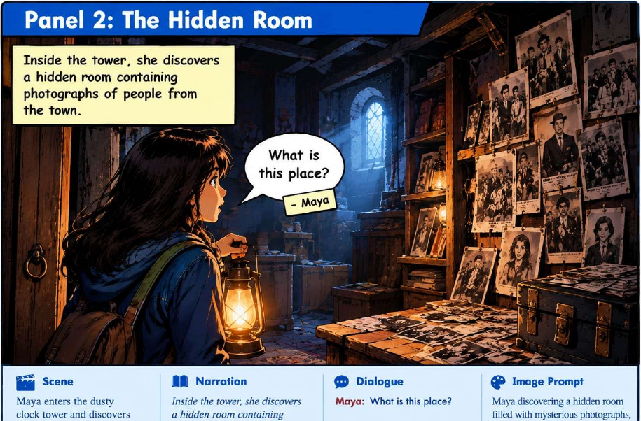
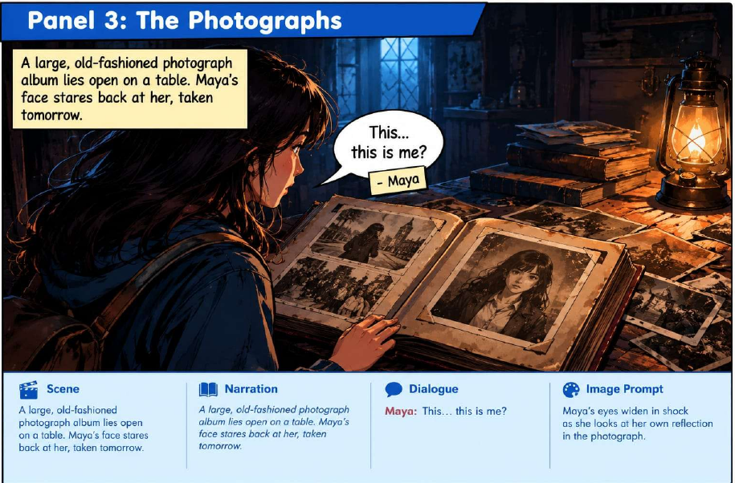
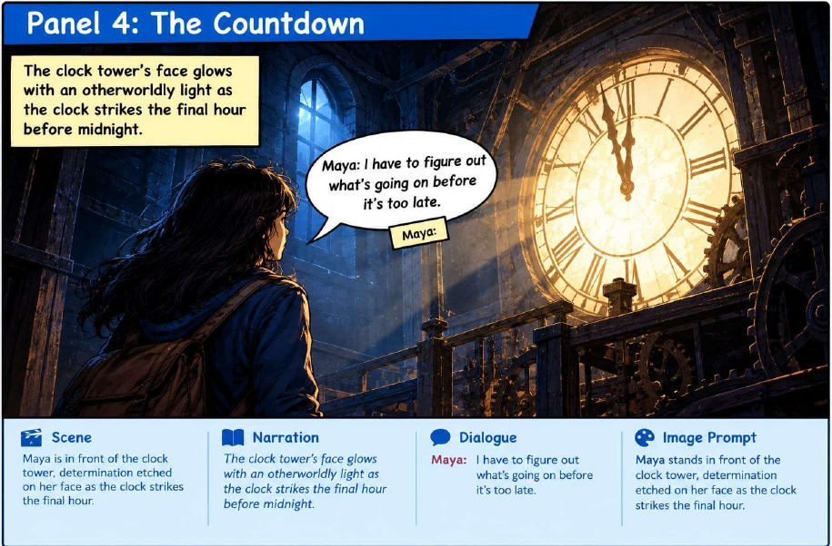
COMICCRAFT AI
AI Comic Story Creator
Transforming a simple idea into a visual comic
GENERATIVE AI
STORYTELLING
COMIC VISUALS
Project presentation
Your Name
From prompt → story → comic

Slide 2
01 INTRO
Introduction
What ComicCraftAI is designed to do
From idea to visual story
ComicCraftAI is an AI-powered application that transforms a simple story idea into a panel-based comic. The project combines story generation, scene descriptions, narration/dialogue, and comic-style illustrations.
A user-friendly creative flow
The interface collects the user’s story prompt and creative choices, then presents the generated comic as a visual preview for review and sharing.
STORY
NARRATION
DIALOGUE
ILLUSTRATION
Based on the ComicCraftAI project documentation and generated comic preview.

Slide 3
How can we turn a simple story idea
into a complete visual comic using AI?
THE CENTRAL QUESTION

Slide 4
02 ANSWER
The ComicCraftAI Approach
A single pipeline connecting user input to a visual result
ComicCraftAI uses Generative AI to transform a simple story idea into a complete, visually engaging comic.
1
2
3
4
5
USER
PROMPT
STORY
PLAN
SCENES +
DIALOGUE
COMIC
IMAGES
FINAL
PREVIEW
Example output: a mystery comic panel with scene, narration and dialogue.
The project documentation describes this end-to-end flow from prompt processing through comic preview and export.

Slide 5
03 OBJECTIVES
Project Objectives
What the system is intended to deliver
1. Generate a structured story
2. Enrich the narrative
Create a panel-by-panel comic storyline from a user’s idea.
Provide scene descriptions, narration and character dialogue.
3. Create comic illustrations
4. Simplify comic creation
Turn scene prompts into visually engaging comic-style panels.
Make the workflow accessible to users without advanced drawing skills.
Core idea
Reduce the effort between “I have a story idea” and “I have a finished comic.”
These objectives are aligned with the project documentation’s stated content and user experience goals.

Slide 6
04 ARCHITECTURE
System Architecture
Frontend, backend and AI services work as one pipeline
Frontend
Backend
AI Layer
Output
HTML • CSS • Jinja2
Collects prompt, character, style and other creative inputs.
FastAPI
Receives input, routes requests and coordinates generation.
Gemini + image-generation model
Creates story content, scene prompts and illustrations.
Comic preview
PDF export
Project structure
Execution flow
app/
1
User submits story and settings
main.py
FastAPI entry point
routes.py
Request routing
2
FastAPI validates and processes input
services/
Business logic
image_generator.py
Image generation
3
Story / scene prompts are prepared
comic_page.py
Comic-page assembly
Images are generated and saved
templates/
4
index.html
User interface
5
Comic page is assembled for preview / export
static/generated/
Generated images
Architecture terminology follows the provided ComicCraft project documentation; file structure also reflects the implemented project workflow.

Slide 7
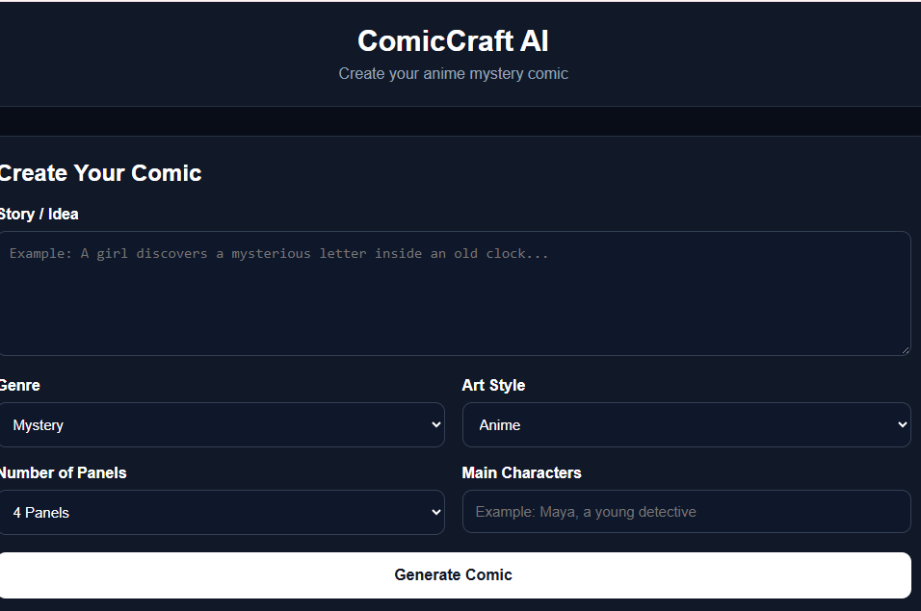
05 USER INPUT
User Interface
The user controls the creative direction before generation
Inputs visible in the project UI
Story / Idea
Genre
Art Style
Number of Panels
Main Characters
Example test
Mystery + Anime • 4 panels
The screenshot is from the local ComicCraftAI interface used during project testing.

Slide 8
06 OUTPUT
Generated Comic Output
Panel-by-panel storytelling with visuals and narrative context
Panel 1 • Midnight Chime
Panel 2 • Hidden Room
Panel 3 • The Photographs
Panel 4 • The Countdown
Each generated panel combines a visual scene with story context, dialogue and an image prompt reference.
SCENE
NARRATION
DIALOGUE
IMAGE PROMPT
The project PDF shows four generated panels for “The Broken Clock Tower,” including scene, narration, dialogue and image-prompt information.

Slide 9
07 IMPLEMENTATION
Implementation Snapshot
A few small code pieces that show how the application is wired together
app/main.py
app/services/image_generator.py
templates/index.html
@app.post("/api/generate")
def generate_comic(data: ComicRequest):
panels = []
for panel_number in range(1, data.panels + 1):
image_path = generate_image(...)
panels.append({
"panel_number": panel_number,
"image_url": "/" + image_path
})
return {"success": True,
"panels": panels}
def generate_image(
prompt: str,
filename: str = "comic_panel.png",
genre: str = "Mystery",
style: str = "Anime",
):
final_prompt = f"""
{style} comic illustration
{genre} atmosphere
{prompt}
"""
# generate and save image
return saved_path
const response =
await fetch("/api/generate", {
method: "POST",
headers: {
"Content-Type":
"application/json"
},
body: JSON.stringify({
story, genre, style,
panels, characters
})
});
const data =
await response.json();
These snippets are implementation-oriented extracts from the ComicCraftAI project structure used in the working flow.

Slide 10
08 CONCLUSION
Result & Future Scope
Where the project stands and how it can grow
What the project demonstrates
Future scope
A simple interface can capture the creative intent of the user.
User profiles
AI can structure the story into distinct comic panels.
Comic libraries
Visuals and narrative can be presented together as a comic preview.
Multi-page story arcs
The generated comic can be prepared for offline sharing through PDF export.
Stronger consistency across characters and scenes
ComicCraftAI turns “just an idea” into something you can see, read and share.
The future-scope items are drawn from the project documentation’s stated enhancement directions.

